Slide 1
Digital Self Defense
Staying safe in the digital age
Jason Chambers
© 2019

Slide 2
Q. How do they get hold of my login/password (credentials)?
Q. What can I do to avoid becoming a victim?
Goals:
Provide answers
Teach you how to boost your defenses
Q. Am I being targeted?
Q. Why do businesses keep getting hacked?
Q. Why is it so hard for businesses to avoid getting hacked?

Slide 3
Low
High
Your defenses
Risk
Consequences
Cost to adversary

Slide 4
How do they get hold of my login/password?

Slide 5
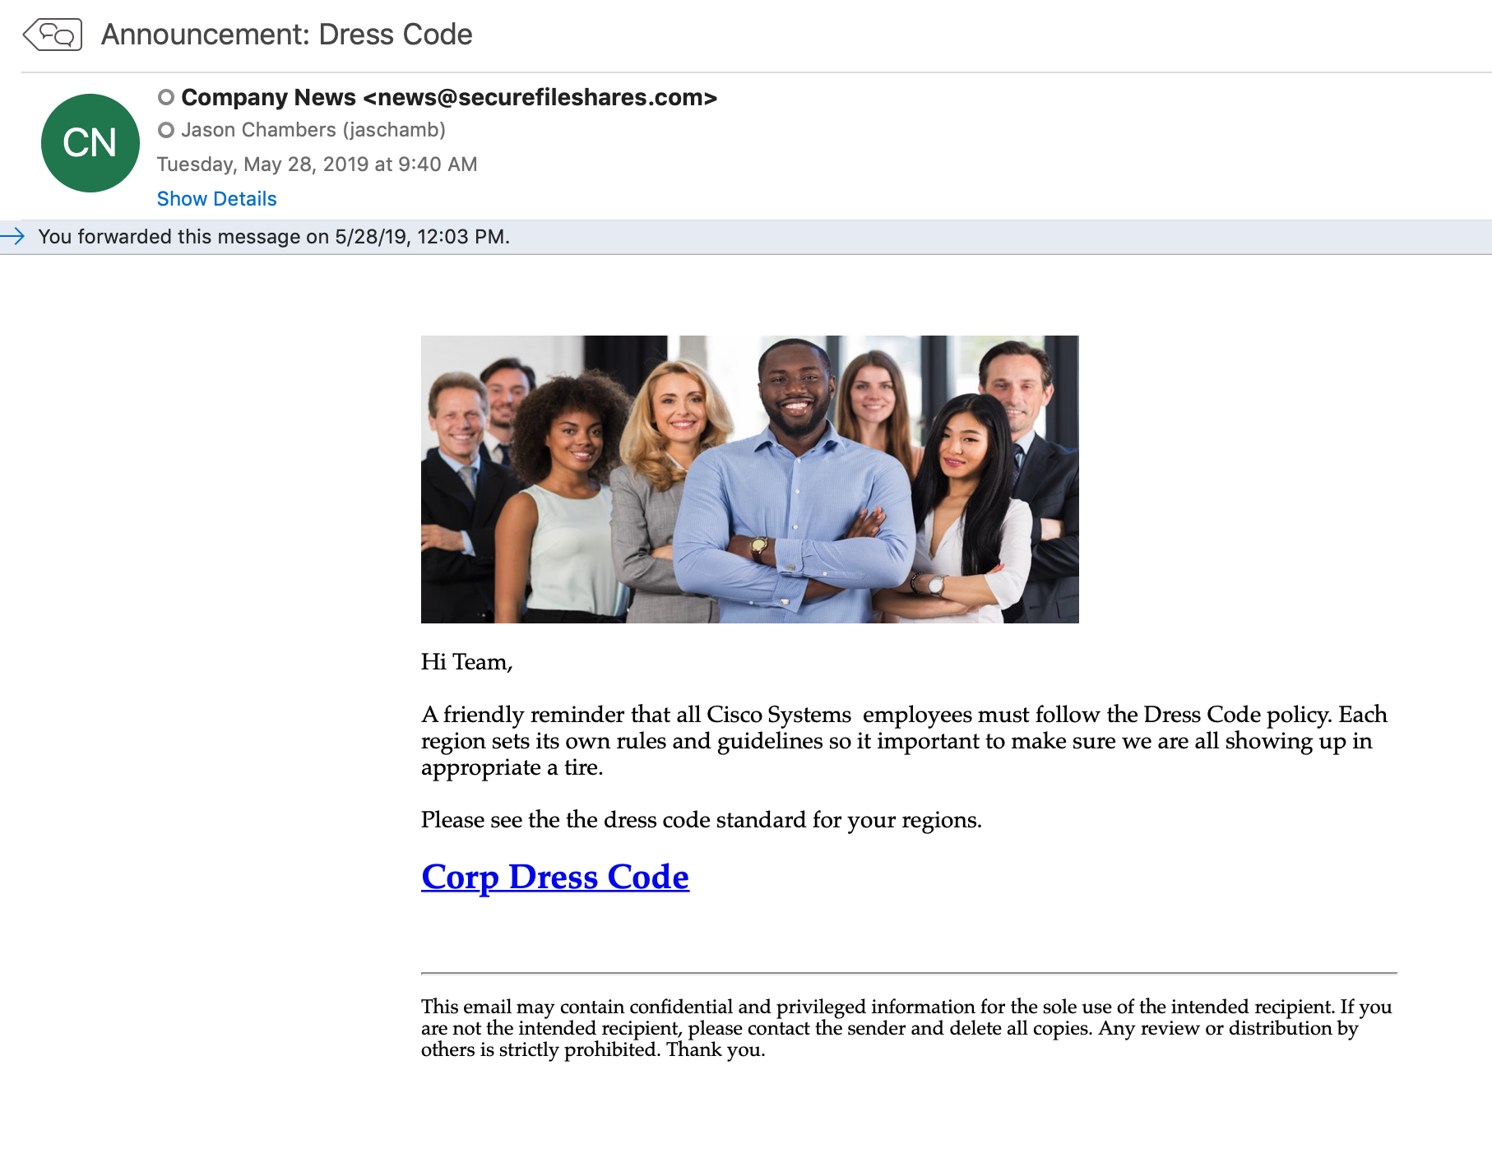
Social Engineering
1. You are tricked into providing them
Phishing
90% of all attacks on enterprise networks are the result of a successful phishing attack.
97% of people are unable to identify a sophisticated phishing email

Slide 6
Malicious Software
Spyware
e.g. Key Loggers
2. Malware
How does it get installed?
Social Engineering
Infiltrate
Vulnerable devices
Question – What is the pattern here?

Slide 7
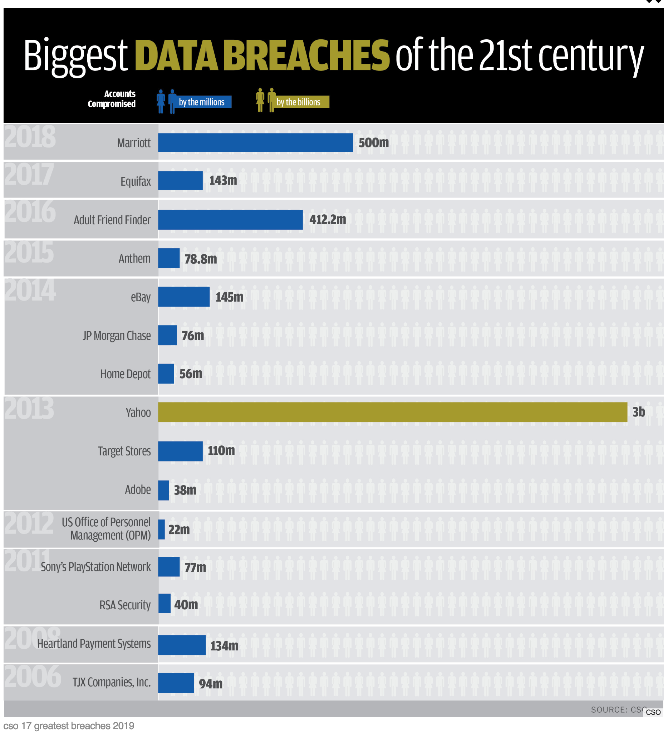
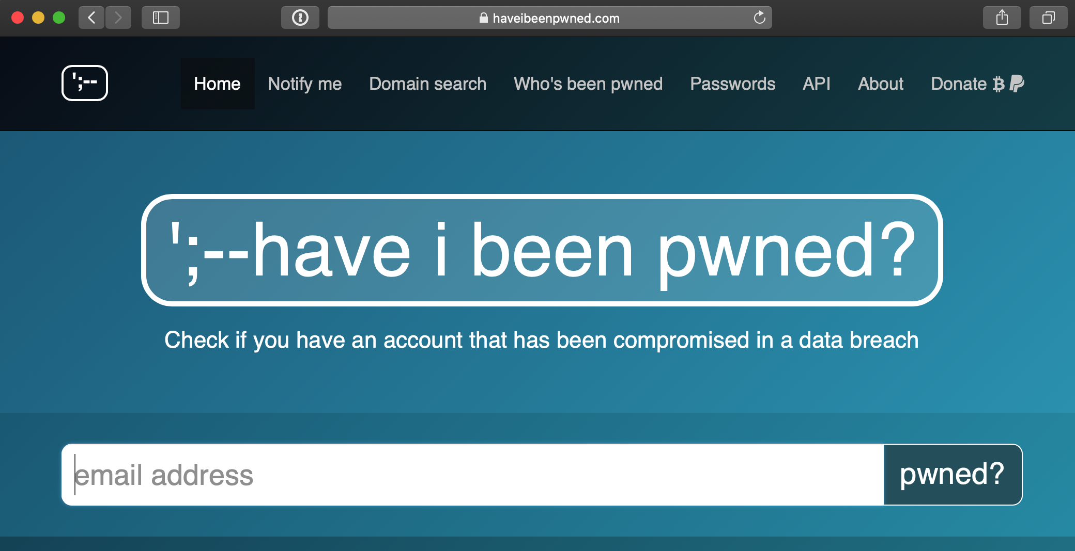
Credentials Spill
Data bounty put up for sale on Dark Web
3. Data Breach
Account Takeover

Slide 8
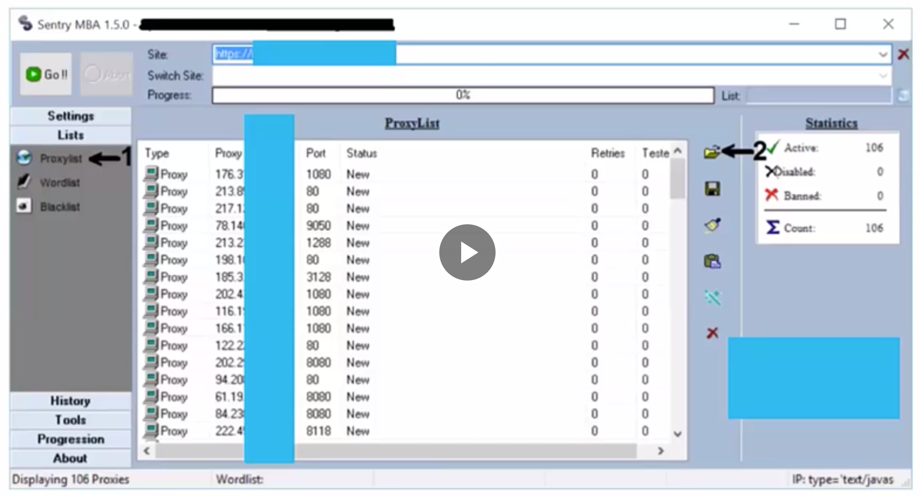
Test spilled credentials on other sites
Evade detection
4. Credential Stuffing
Automated attack
Using botnet/infected devices
Question – what might you do to protect yourself from a Credential Stuffing attack?
Question – with your new found knowledge, do you think you are being targeted?

Slide 9
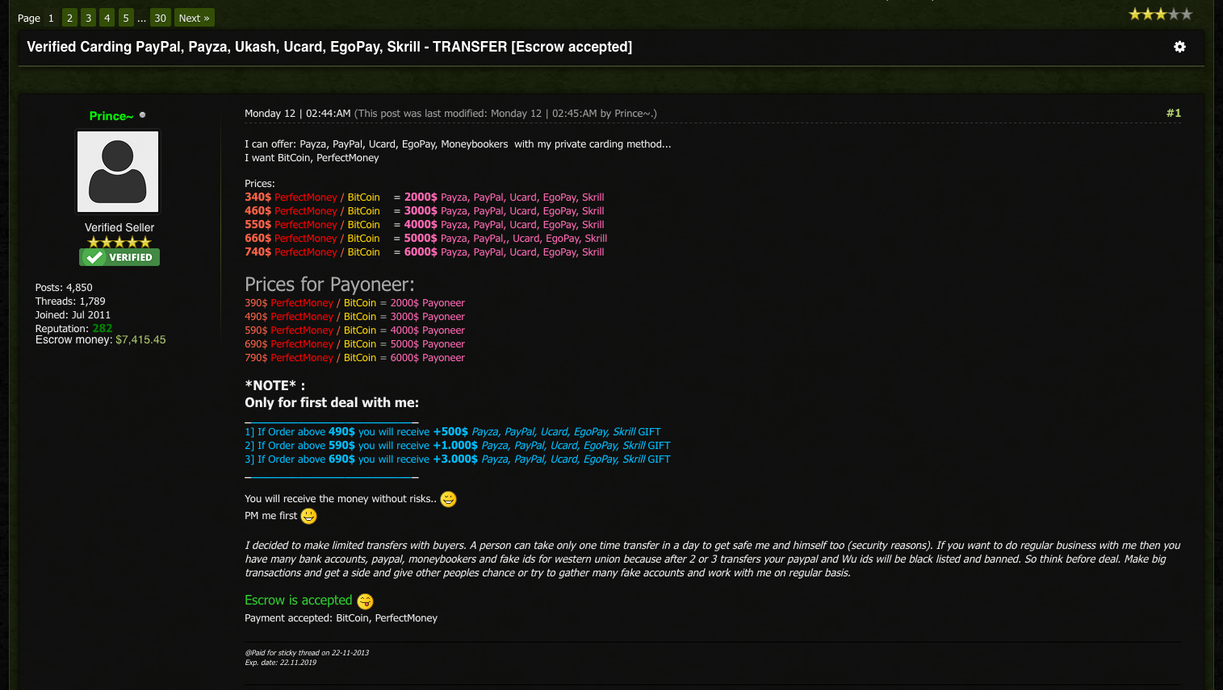
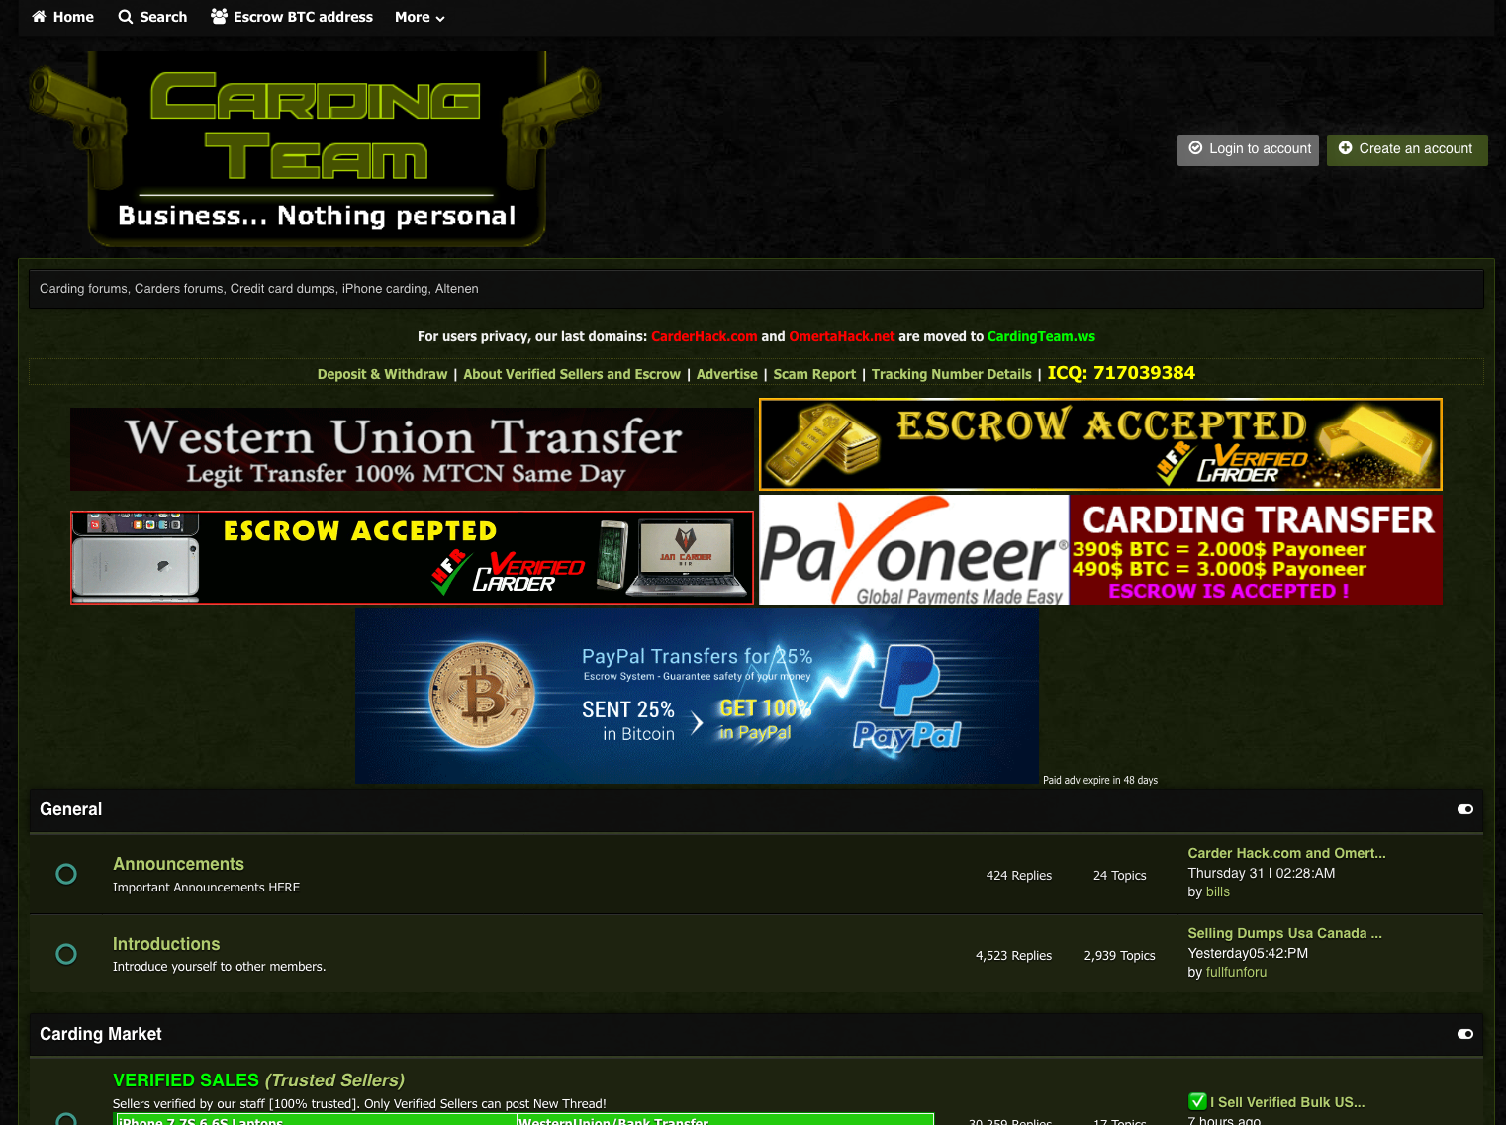
Previously spilled credentials
5. They can bought on the Dark Web
For $20-$200
Wait? What? Anybody care to do the math?
Q – What is more valuable? – your e-mail credentials or your banking credentials?

Slide 10
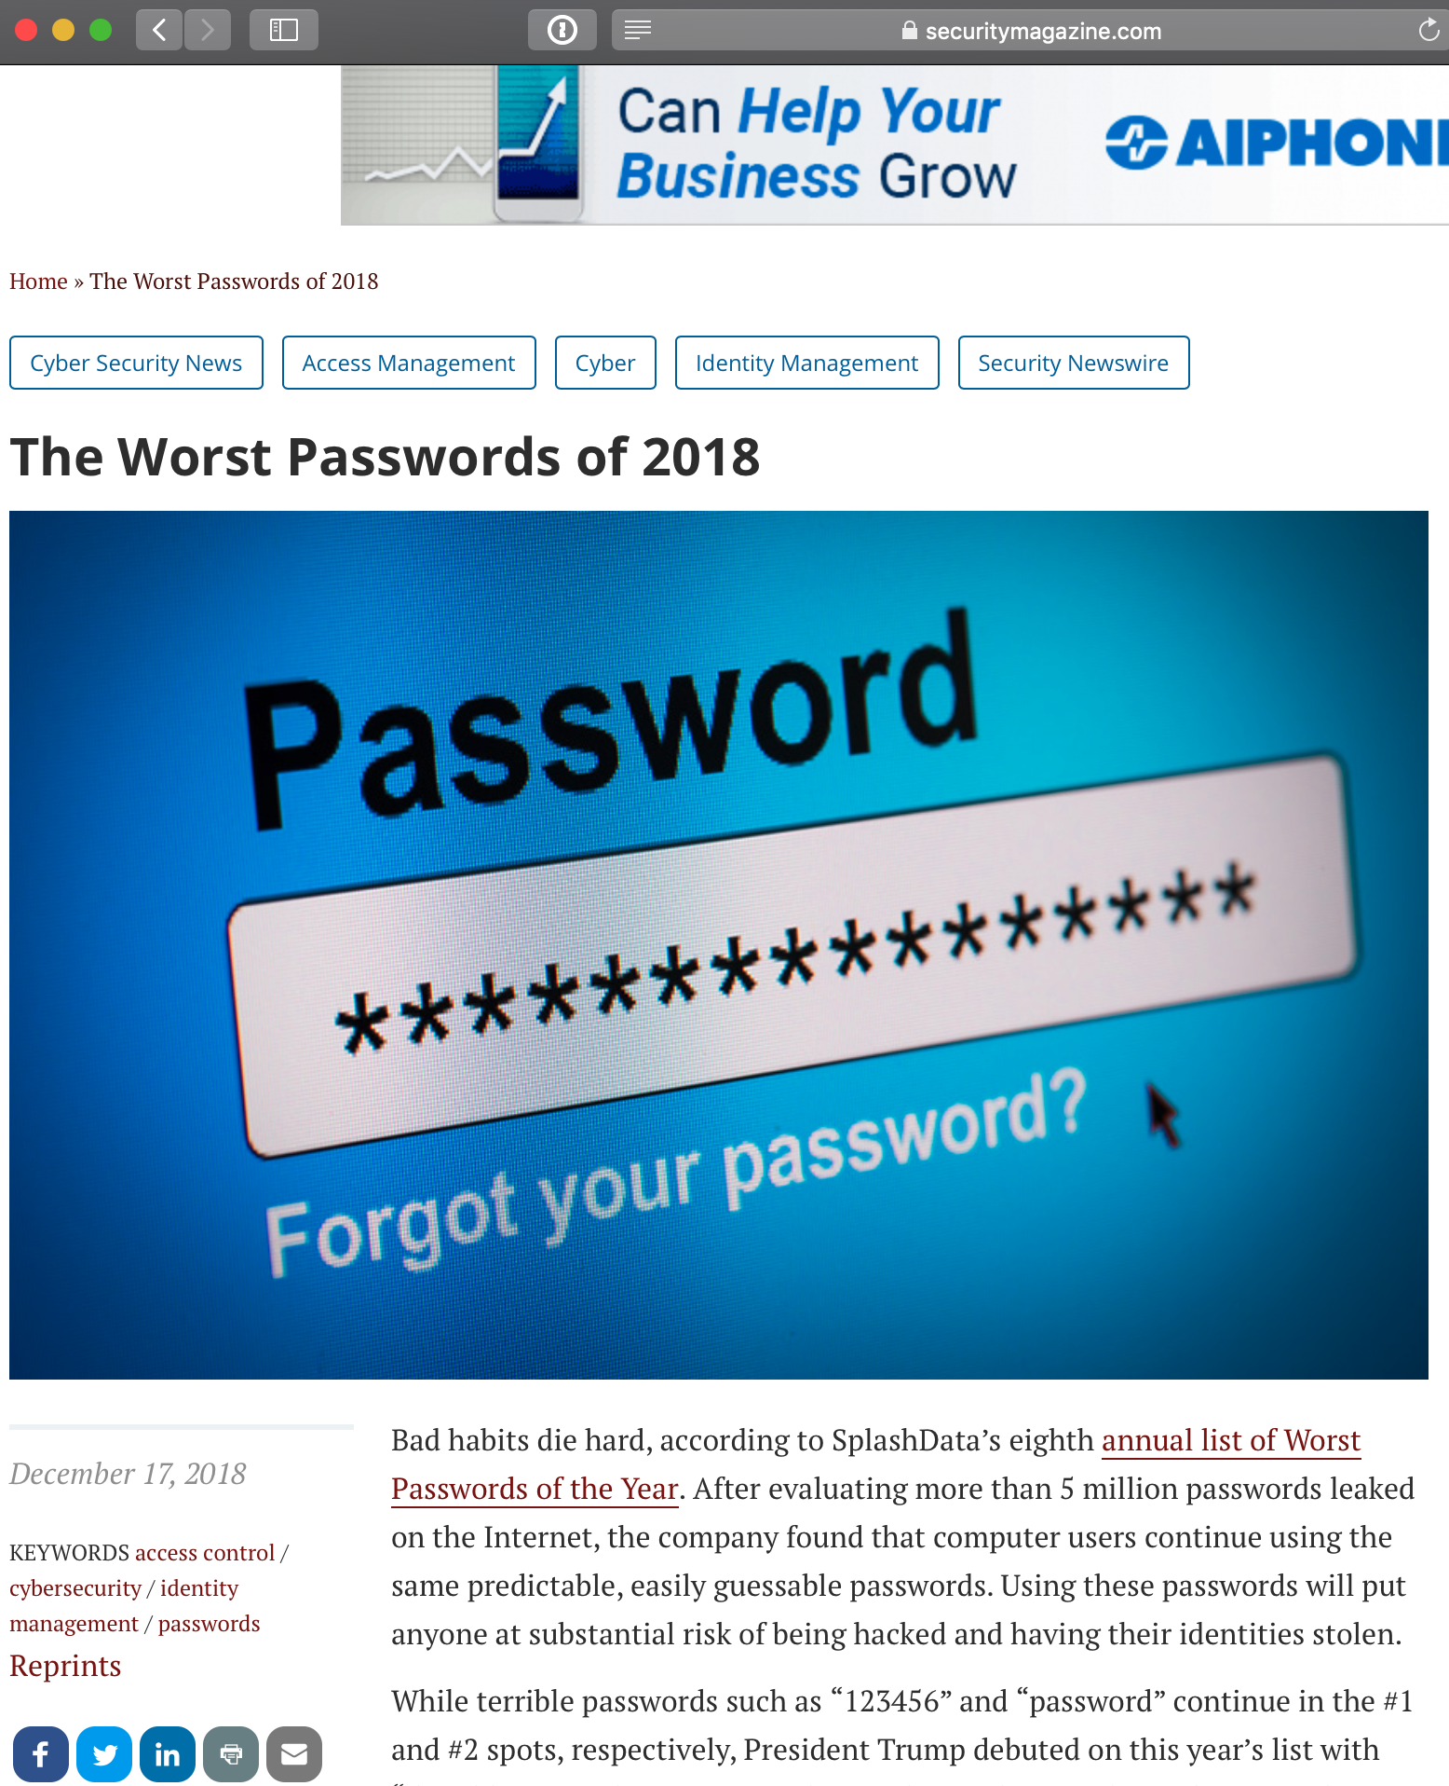
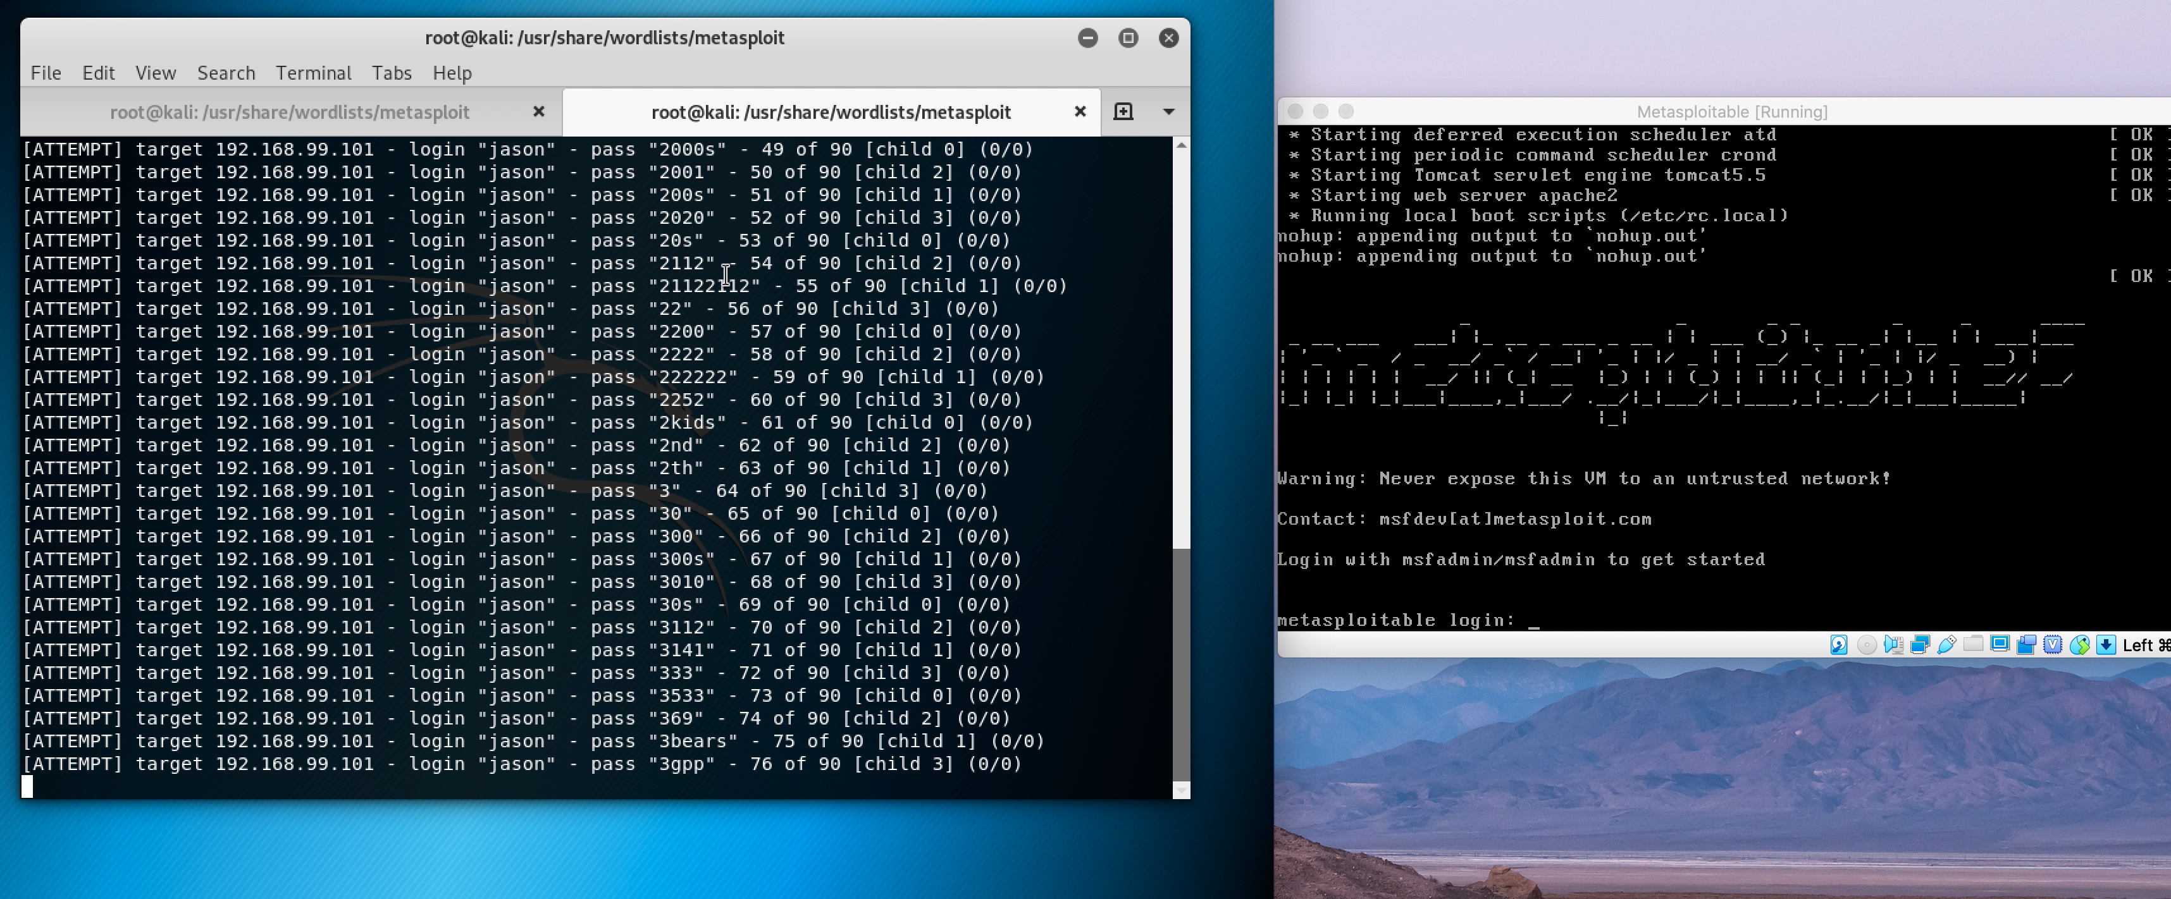
Targeted?
Expect big returns
6. Brute force attempts
Slow (expensive)
Simple passwords can be cracked fairly quickly
Question – what might you do to frustrate somebody who is conducting a brute-force attack?
If we have time, I can demo a brute-force attack

Slide 11
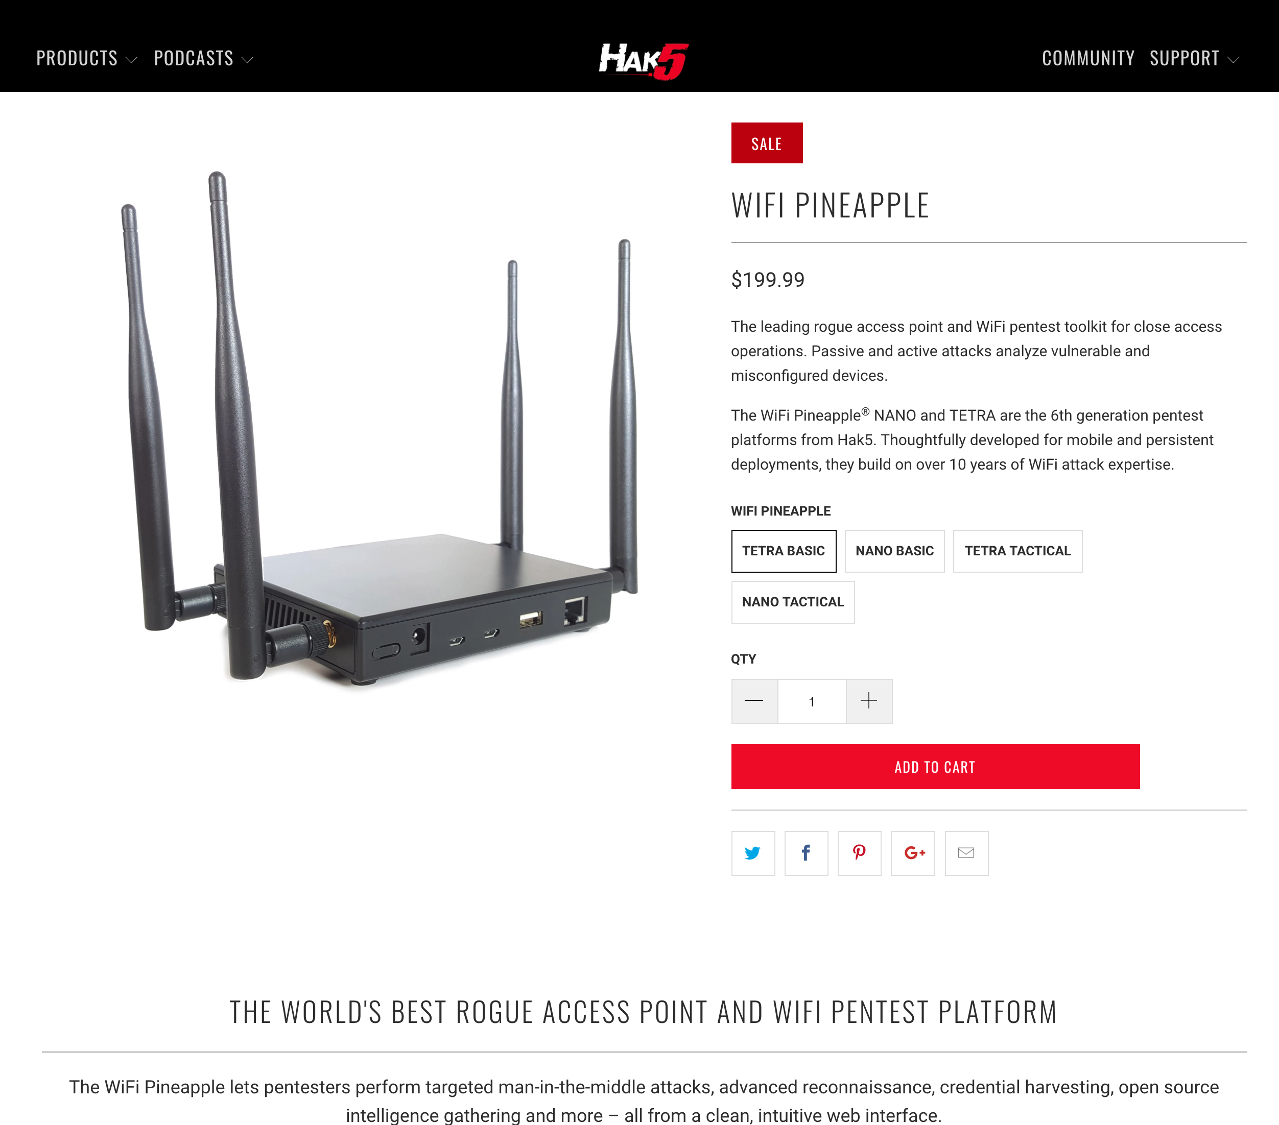
Think of it as a public swimming pool
Man-in-the-middle attacks
7. Public Wifi
Wifi sniffing

Slide 12
8. Do you have them written down?

Slide 13
What can I do to avoid becoming a victim?

Slide 14
Unless you choose to live off the grid, it’s impossible to avoid risk altogether
You can however take steps to reduce your risk
Ready?

Slide 15
Use a Password Manager

Slide 16
Change all your on-line passwords using a different strong password for each

Slide 17
Turn on 2FA for your accounts (start with e-mail)

Slide 18
Find out if you have been compromised (hint: you probably have been already)

Slide 19
Learn the signs of phishing campaigns

Slide 20
Never give out personal or sensitive information until you have verified who you are talking to

Slide 21
E-mail (and SMS) is not confidential – encrypt sensitive files before sending them

Slide 22
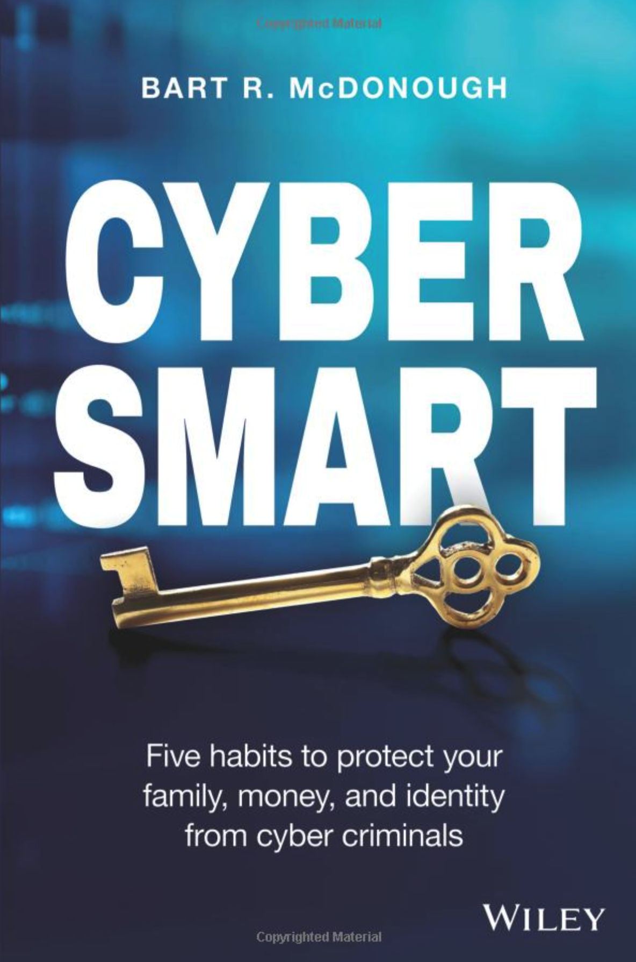
Buy this book

Slide 23
Freeze your credit

Slide 24
Monitor your credit

Slide 25
Monitor your banking activity (alerts)

Slide 26
Confirm wiring instructions over the phone AND lookup routing number and IBAN – never blindly trust e-mail messages

Slide 27
Be wary of on-line dating scams

Slide 28
Know it is easy to spoof Caller ID – it is not the IRS or Technical Support that is calling you

Slide 29
Invest in a secure on-line backup service (if you want to recover from a Ransomware attack)

Slide 30
Turn on hard-drive encryption – in case your laptop is stolen

Slide 31
Wipe clean your old Mac/PC/Device before selling/donating it

Slide 32
Take care using free public Wifi – use a VPN
(Be careful at airports especially)

Slide 33
Check https://haveibeenpwned.com/

Slide 34
Spread the word

